Slide 1
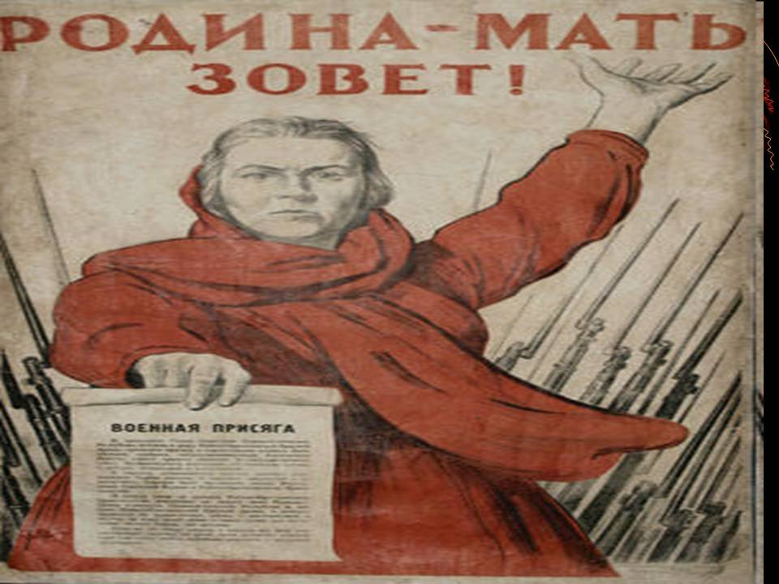
Great Patriotic War 1941 - 1945

Slide 2
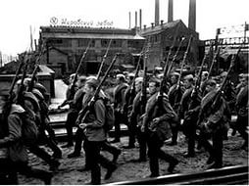
The Great Patriotic War lasted for over 4 years, from 1941 until 1945.

Slide 3
Every year on May, 9, we celebrate the VICTORY DAY

Slide 4
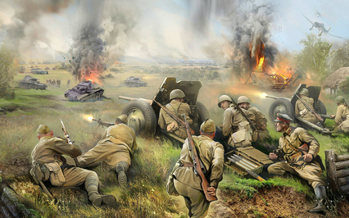
My grandfather was in this war. It is his and our high-day

Slide 5
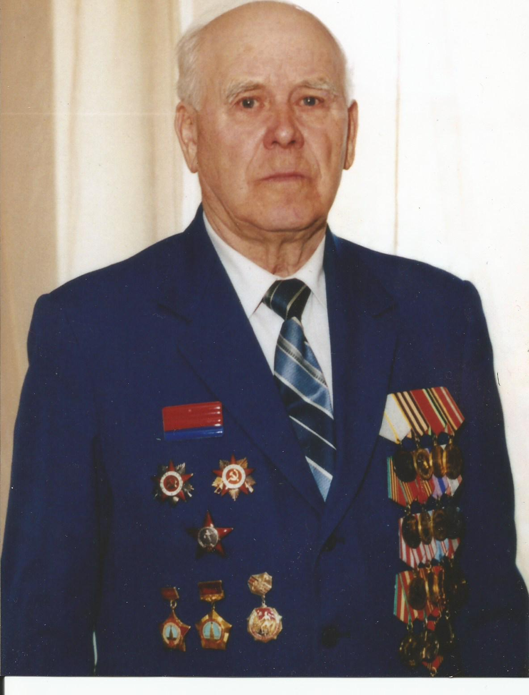
My great grandfather
Shmitov
Nikolai Vasilievich,
a veteran of the
Great Patriotic War

