Slide 1
MY ROLE MODEL
Evgeny Malkin

Slide 2
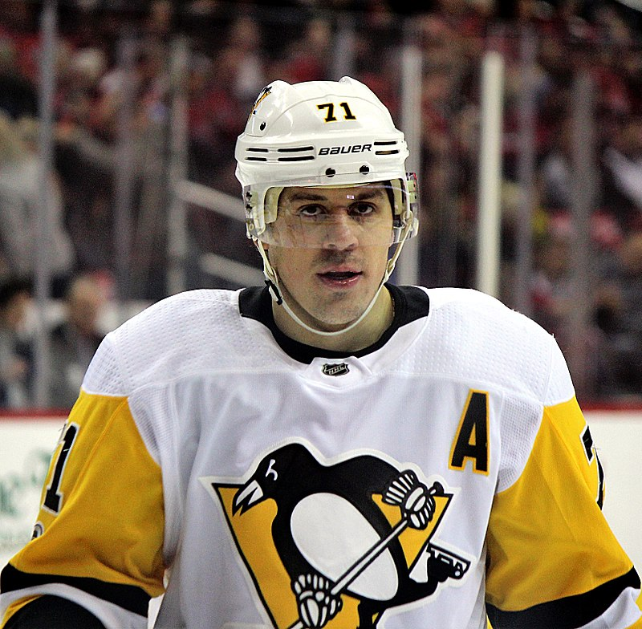
Who is Evgeny Malkin?
Evgeny Malkin is a Russian hockey player. He is the central striker of the NHL team "Pittsburgh Penguins" and the Russian national team. Evgeny has been the winner of the Stanley Cup three times with the Pittsburgh Penguins. He has also been the world champion twice. He was a participant of three Olympic Games, in 2006, 2010, and 2014. He is an honored master of sport in Russia.

Slide 3
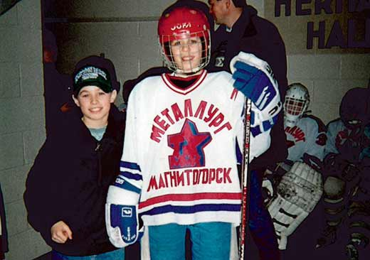
Early years.
Evgeniy Malkin was born on July 31st, 1986 in Magnitogorsk.
His dad used to be a hockey player himself. He became Evgeny’s first coach. He taught his son to skate when he was 3 years old.
Evgeny performed for the Magnitogorsk club for 3 seasons.

Slide 4
Career in the Pittsburgh Penguins.
In 2004, he participated in the Junior World Championship in Minsk and became the world champion as a player of the Russian national team.
On September 5th, 2006, he signed a contract with the Pittsburgh Penguins.
In the seasons of 2009, 2015-2016 together Evgeny became the winner of the Stanley Cup three times.

Slide 5
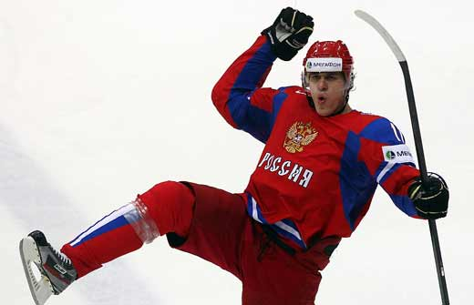
Career in the Russian National Team
Malkin performed for the Russian national team for the first time at the Junior World Championship 2003 in Yaroslavl.
He participated in many world championships.
At the World Cup in 2012 Malkin won the gold medal and was rewarded as the most valuable player of the tournament. At the World Cup in 2014 he became the world champion twice. In 2015, he got the silver medal in the World Cup.
He also took part in three Winter Olympic Games.

