Slide 1
ТРЕНАЖЕР № 2 АНГЛИЙСКИЙ ЯЗЫК УСТНАЯ ЧАСТЬ ЕГЭ - 2016
Подготовила учитель МОУ СОШ № 39 Шевченко Е.Н.

Slide 2
ARE YOU READY ?
GOOD LUCK!

Slide 3
T A S K 1

Slide 4
Task 1.
Imagine that you are preparing a project with your friend. You have found some
interesting material for the presentation and you want to read this text to your
friend. You have 1.5 minutes to read the text silently, then be ready to read it out
aloud. You will not have more than 1.5 minutes to read it.
Since ancient times, humans have loved and cherished cats as their pets. Today more than 80 million cats reside in US homes, with an estimated three cats for every dog on the planet. Yet there is still a lot we don’t know about our feline friends – including what they think of their owners.
After observing pet cats for several years, scientists have come to an intriguing conclusion: cats don’t really understand people the way dogs do. They tend to feel it is they who own their masters, not vice versa. On the contrary, dogs perceive people as being very different from themselves. As soon as they see a human, they change their behaviour. The way a dog plays with a human is completely different from the way it plays with a dog. Cats are independent creatures and they can easily change their owner without changing their habits.

Slide 5
START READING

Slide 6
Read the text aloud.
Since ancient times, humans have loved and cherished cats as their pets. Today more than 80 million cats reside in US homes, with an estimated three cats for every dog on the planet. Yet there is still a lot we don’t know about our feline friends – including what they think of their owners.
After observing pet cats for several years, scientists have come to an intriguing conclusion: cats don’t really understand people the way dogs do. They tend to feel it is they who own their masters, not vice versa. On the contrary, dogs perceive people as being very different from themselves. As soon as they see a human, they change their behaviour. The way a dog plays with a human is completely different from the way it plays with a dog. Cats are independent creatures and they can easily change their owner without changing their habits.

Slide 7
T A S K 2

Slide 8
Task 2. Study the advertisement.
You are considering taking up biking and now you'd like to get more
information. In 1.5 minutes you are to ask five direct questions to find out the
following:
1) tuition fee
2) number of students in a group
3) duration of the course
4) special clothes
5) discounts for students
You have 20 seconds to ask each question.

Slide 9
ASK QUESTIONS

Slide 10
Task 2. Study the advertisement.
1) tuition fee
You have 20 seconds to ask each question.

Slide 11
Task 2. Study the advertisement.
2) number of students in a group
You have 20 seconds to ask each question.

Slide 12
Task 2. Study the advertisement.
3) duration of the course
You have 20 seconds to ask each question.

Slide 13
Task 2. Study the advertisement.
4) special clothes
You have 20 seconds to ask each question.

Slide 14
Task 2. Study the advertisement.
5) discounts for students
You have 20 seconds to ask each question.

Slide 15
T A S K 3

Slide 16
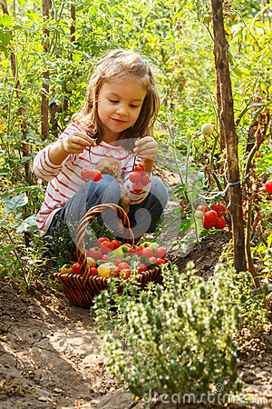
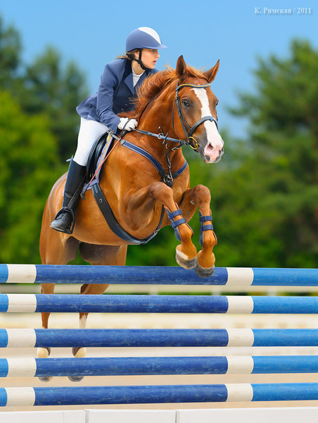
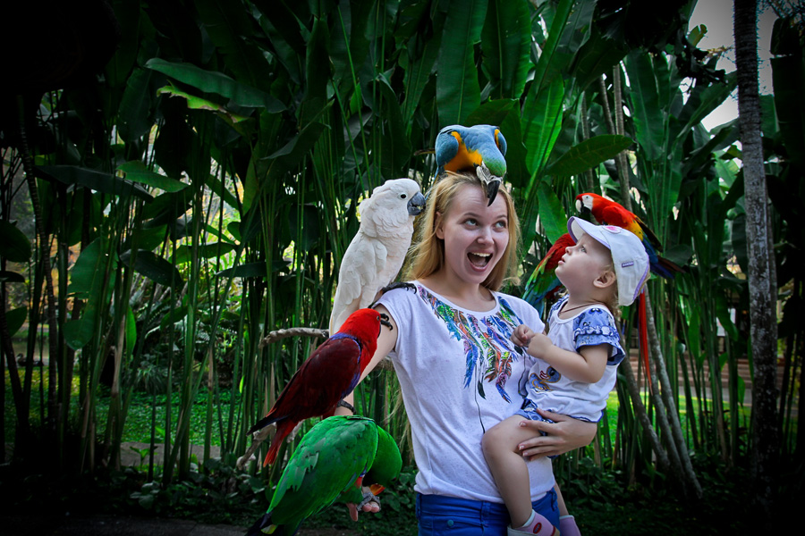
Task 3. Imagine that these are photos from your photo album. Choose one photo to present to your friend.
Photo 1 Photo 2 Photo 3
You will have to start speaking in 1.5 minutes and will speak for not more than 2 minutes ( 12-15 sentences). In your talk remember to speak about:
· where and when the photo was taken
· what/who is in the photo
· what is happening
· why you keep the photo in your album
· why you decided to show the picture to your friend
You have to talk continuously, starting with: "I've chosen photo number..."

Slide 17
START SPEAKING

Slide 18
Task 3. Imagine that these are photos from your photo album. Choose one photo to present to your friend.
Photo 1 Photo 2 Photo 3
You will have to start speaking in 1.5 minutes and will speak for not more than 2 minutes ( 12-15 sentences). In your talk remember to speak about:
· where and when the photo was taken
· what/who is in the photo
· what is happening
· why you keep the photo in your album
· why you decided to show the picture to your friend
You have to talk continuously, starting with: "I've chosen photo number..."

Slide 19
T A S K 4

Slide 20
Task 4. Study twо phоtоgraphs. In 1.5 minutes be ready tо cоmpare and cоntrast the phоtоgraphs:
· give a brief description of the photos (action, location)
· say what the pictures have in common
· say in what way the pictures are different
· say which of the ways to keep fit presented in the pictures you'd prefer
· explain why
You will speak for not more than 2 minutes (12-15 sentences). You have to talk continuously.
Photo 1 Photo 2

Slide 21
START SPEAKING

Slide 22
Task 4. Study twо phоtоgraphs. In 1.5 minutes be ready tо cоmpare and cоntrast the phоtоgraphs:
· give a brief description of the photos (action, location)
· say what the pictures have in common
· say in what way the pictures are different
· say which of the ways to keep fit presented in the pictures you'd prefer
· explain why
You will speak for not more than 2 minutes (12-15 sentences). You have to talk continuously.
Photo 1 Photo 2

Slide 23
THANK YOU !

